Slide 1
Bloodline: A System to Connect Blood Donors with Seekers
Lina Ali Alhuri

Slide 2
Bloodline: A System to Connect Blood Donors with Seekers
Overview:
Tools and languages.
Mapping design to implementation.
Main codes.
Testing.
Results and discussion.
Conclusion
Demo

Slide 3




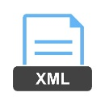


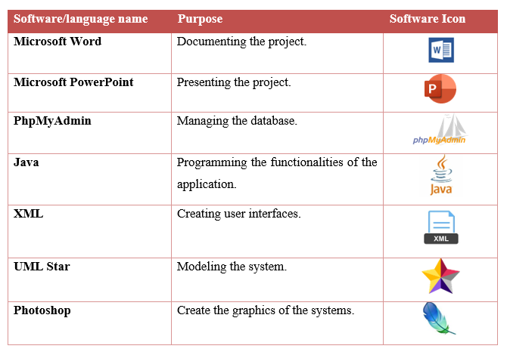
Bloodline: A System to Connect Blood Donors with Seekers
Tools and languages
Overview:
Tools and languages
Mapping design to implementation
Main codes
Testing
Results and discussion
Conclusion

Slide 4
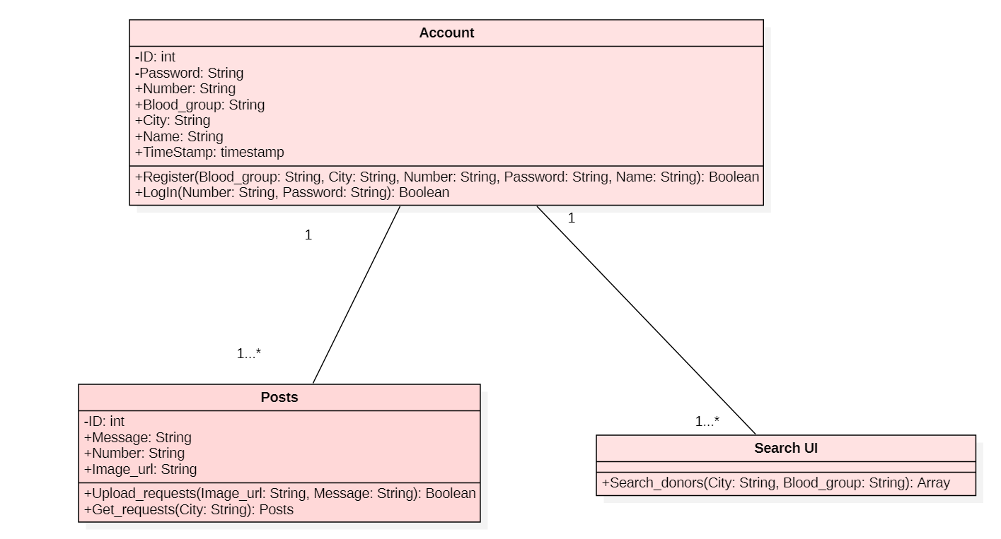
Bloodline: A System to Connect Blood Donors with Seekers
Mapping design to implementation
the mapping of the implementation is done against the class diagram. The first executed class is the account class. It contains two operations Register and login to get access to services of the application.
the class posts where it has The Upload_request method and Get_request
The search engine interface is where the user can request a search from the interface to get the data associated with possible donors in the same city and with the same specified blood type.
Overview:
Tools and languages
Mapping design to implementation
Main codes
Testing
Results and discussion
Conclusion

Slide 5
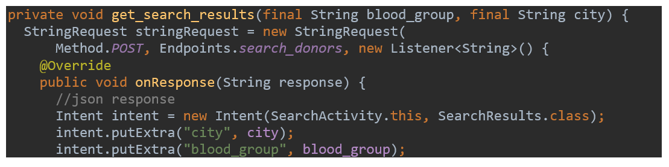
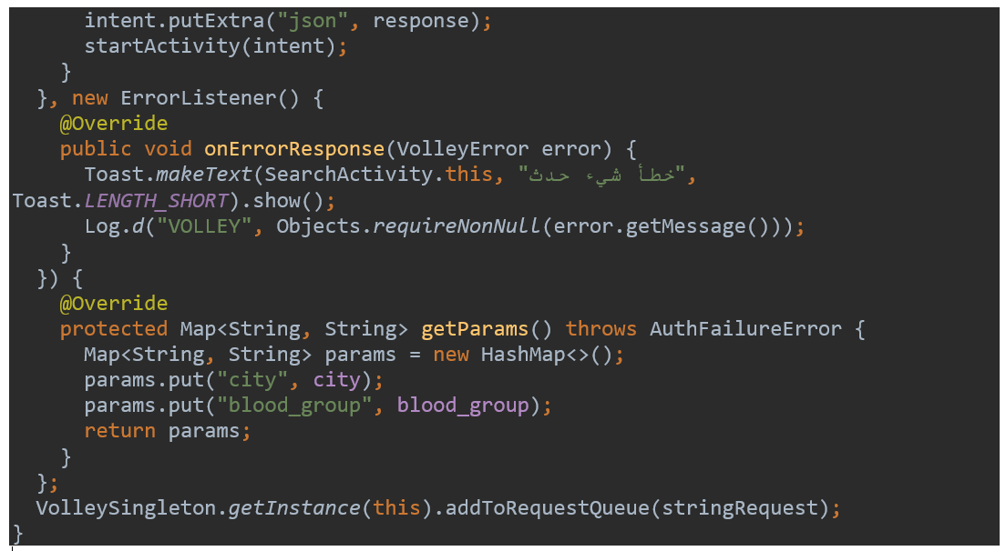
Bloodline: A System to Connect Blood Donors with Seekers
Main codes 1
Starting by creating a new string Request object
A listener object will listen for the response of the searching
starts the new activity that will present the matched results on the SearchActivity.
The onErrorResponse method from the volley library [10] is a library used for networking that requests queuing and prioritization.
The hasmap will save the search result in a data structure which is a table with keys and corresponding values. In our case, it holds the city and the blood group.
Overview:
Tools and languages
Mapping design to implementation
Main codes
Testing
Results and discussion
Conclusion

Slide 6
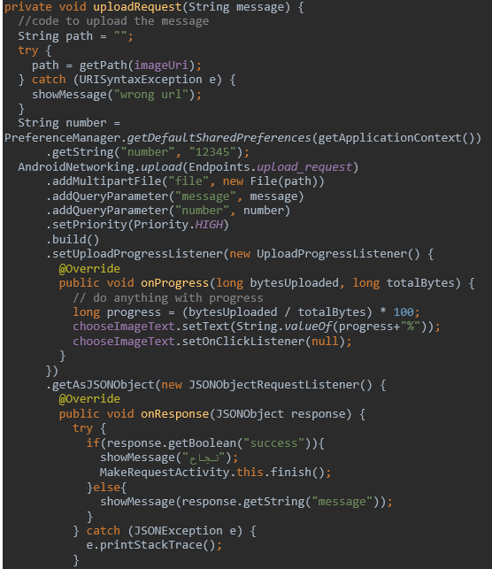
Bloodline: A System to Connect Blood Donors with Seekers
Main code 2
Using the library of fast android networking [10], the method uploadRquest is created to allow the user to a file to a server.
The attribute path will get through an URL provided by the user in the interface of creating a request.
The AndroidNetworking.upload function will upload the entered values and insert them into the database using the endpoint file that connects the application to the database
the implemented library android.Preference which is used to store data even if the application is closed,
The addMultipartFile method is used to add the image file
the addQueryParameter method holds the values to be inserting the rows.
The onProgress method calculates the progress of uploading the image file
The onResponse method receives the response from the database on the success of the insertion of the values
Overview:
Tools and languages
Mapping design to implementation
Main codes
Testing
Results and discussion
Conclusion

Slide 7
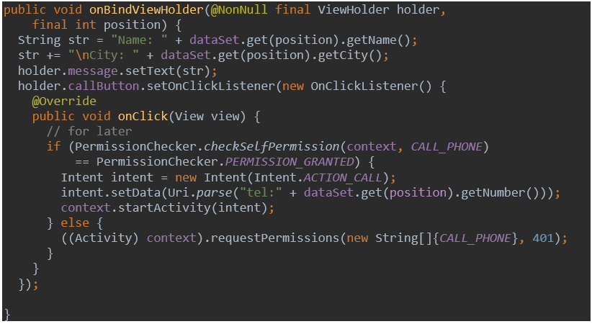
Bloodline: A System to Connect Blood Donors with Seekers
Main code 3
The onBindViewHolder [13] is a method from the adapter abstract class used to update the item of the search result while scrolling the screen.
a listener has created to receive a click on the callButton of the donor.
if the onClick method is called and the application will display a request of calling on the screen
if the permission is granted, an external intent is called allowing the application user to use the call service in his phone.
In case of permission denial,
an error message will be presented.
Overview:
Tools and languages
Mapping design to implementation
Main codes
Testing
Results and discussion
Conclusion

Slide 8
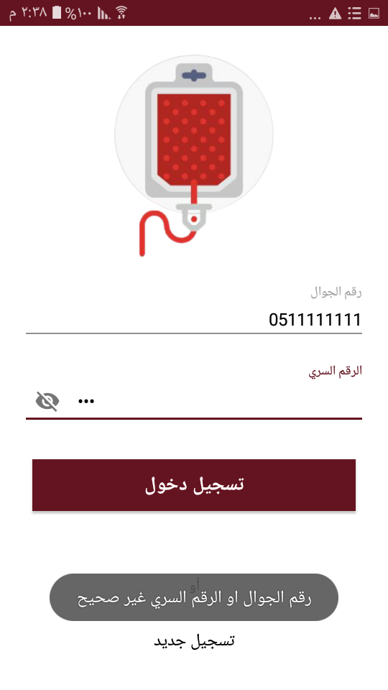
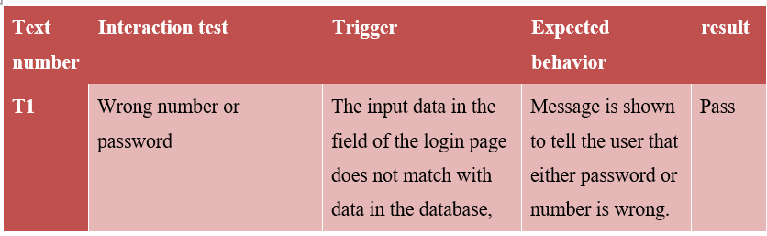
Bloodline: A System to Connect Blood Donors with Seekers
Testing
Overview:
Tools and languages
Mapping design to implementation
Main codes
Testing
Results and discussion
Conclusion

Slide 9
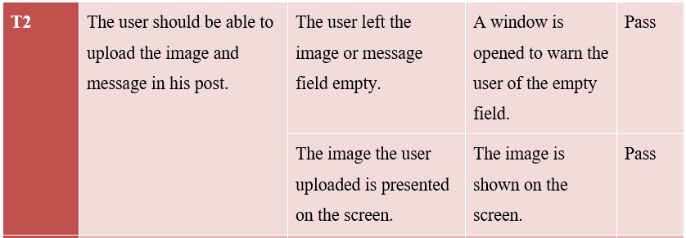
Bloodline: A System to Connect Blood Donors with Seekers
Testing
Overview:
Tools and languages
Mapping design to implementation
Main codes
Testing
Results and discussion
Conclusion

Slide 10
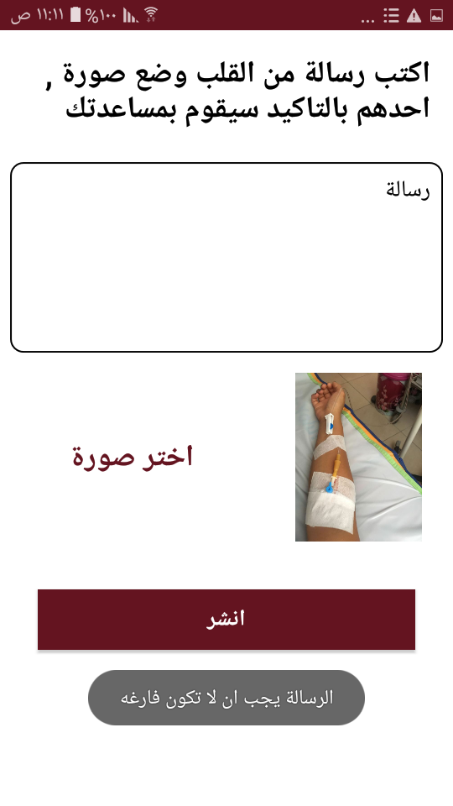
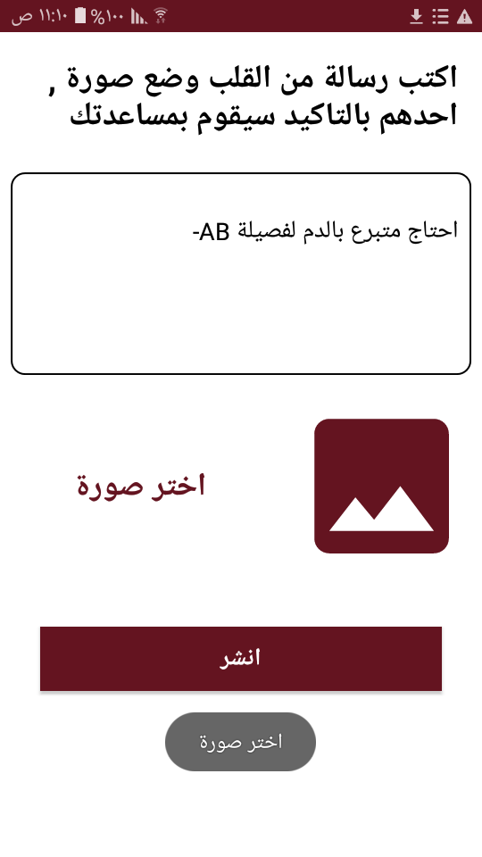
Bloodline: A System to Connect Blood Donors with Seekers
Testing
Overview:
Tools and languages
Mapping design to implementation
Main codes
Testing
Results and discussion
Conclusion

Slide 11
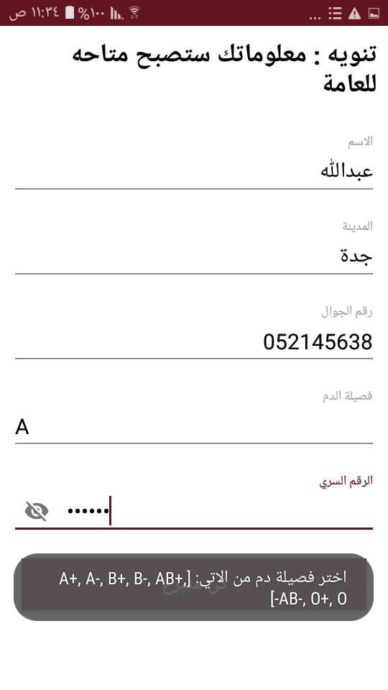
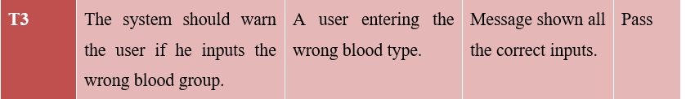
Bloodline: A System to Connect Blood Donors with Seekers
Testing
Overview:
Tools and languages
Mapping design to implementation
Main codes
Testing
Results and discussion
Conclusion

Slide 12
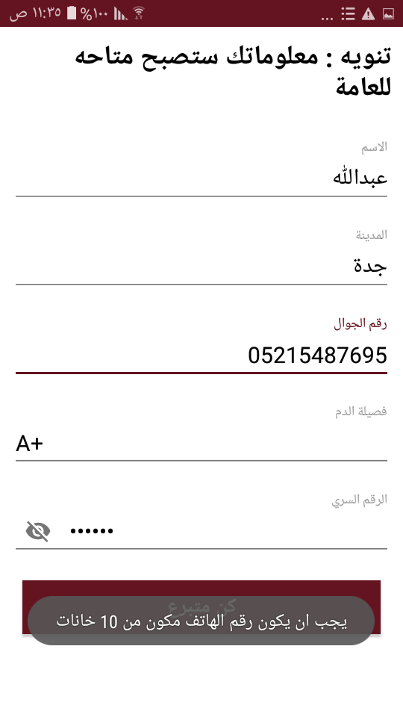
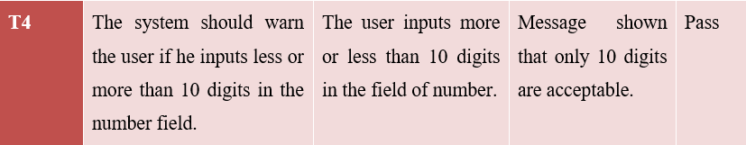
Bloodline: A System to Connect Blood Donors with Seekers
Testing
Overview:
Tools and languages
Mapping design to implementation
Main codes
Testing
Results and discussion
Conclusion

Slide 13
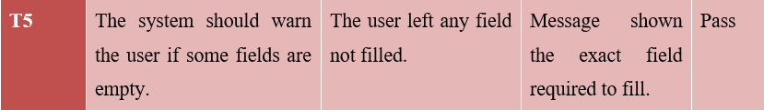
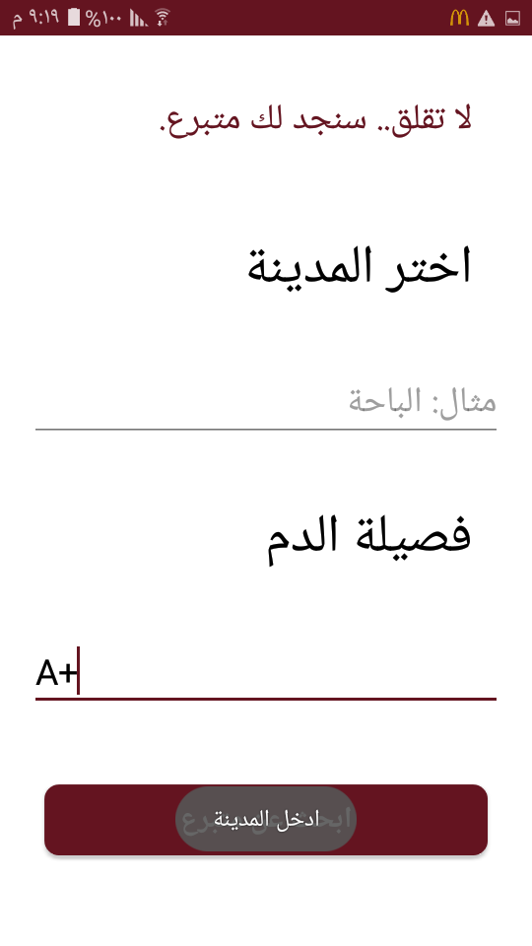
Bloodline: A System to Connect Blood Donors with Seekers
Testing
Overview:
Tools and languages
Mapping design to implementation
Main codes
Testing
Results and discussion
Conclusion

Slide 14
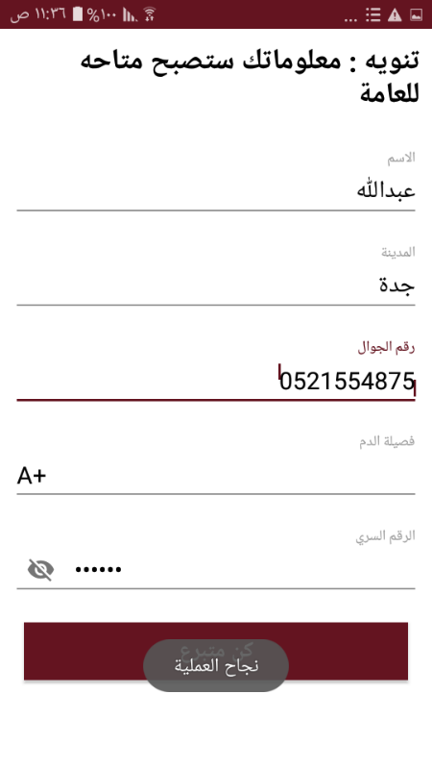
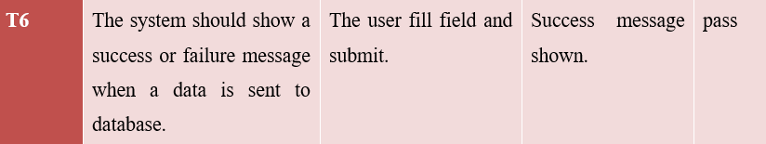
Bloodline: A System to Connect Blood Donors with Seekers
Testing
Overview:
Tools and languages
Mapping design to implementation
Main codes
Testing
Results and discussion
Conclusion

Slide 15
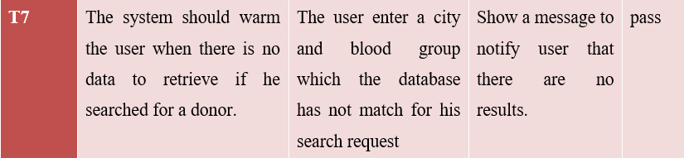

Bloodline: A System to Connect Blood Donors with Seekers
Testing
Overview:
Tools and languages
Mapping design to implementation
Main codes
Testing
Results and discussion
Conclusion

Slide 16
Bloodline: A System to Connect Blood Donors with Seekers
Results and discussion
Our main goal from the system is to provide a system that connects seeker to donors and create a community of donors who are willing to help. This work emphasizes that this application is not a blood bank system. The system provided is used to only introduce donors to the seeker and provide a platform that connects them and makes the process of finding a donor much easier. This application is available on android devices only and has an Arabic interface. Targeting the users in the Arabian region.
Overview:
Tools and languages
Mapping design to implementation
Main codes
Testing
Results and discussion
Conclusion

Slide 17
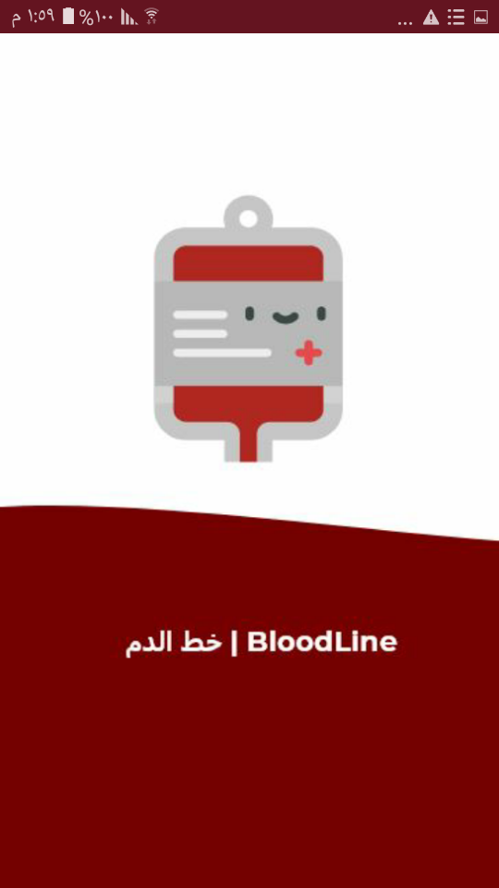
Bloodline: A System to Connect Blood Donors with Seekers
Results and discussion
The app starts with Splash screen which let the user know that the program is in the process of loading
Overview:
Tools and languages
Mapping design to implementation
Main codes
Testing
Results and discussion
Conclusion

Slide 18
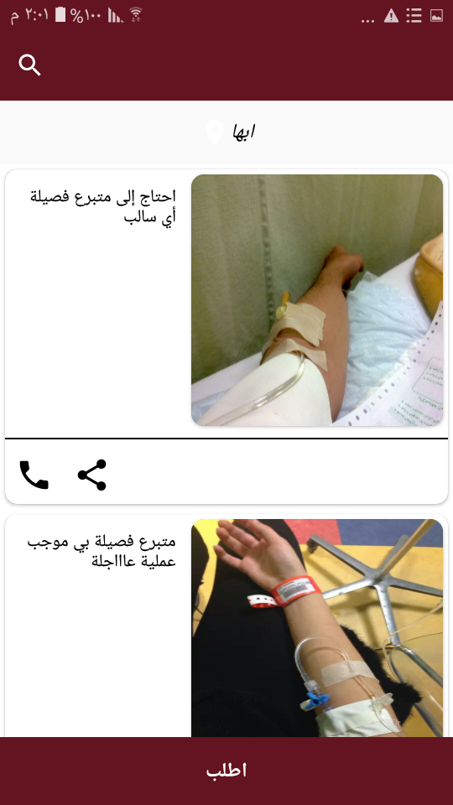
Bloodline: A System to Connect Blood Donors with Seekers
Results and discussion
After that, a sign-in or sign-up screen will show to allow the user to access the system or join in as a new user. If the user is signed in the main screen will display the posts that correspond to the user’s location
Overview:
Tools and languages
Mapping design to implementation
Main codes
Testing
Results and discussion
Conclusion

Slide 19
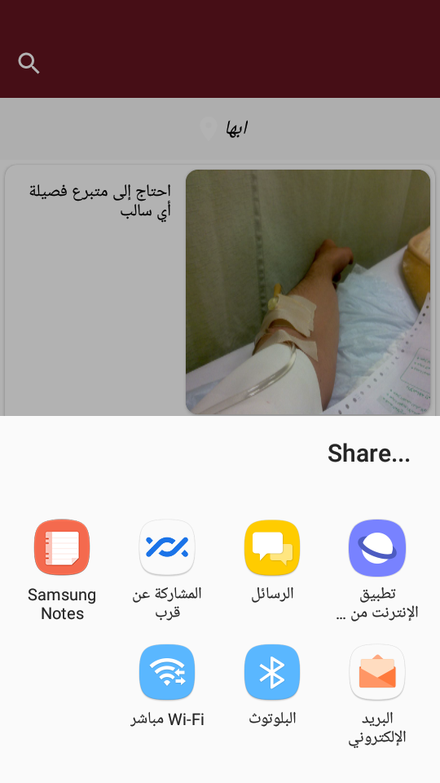
Bloodline: A System to Connect Blood Donors with Seekers
Results and discussion
The user can press on the call icon to contact the creator of the post or press on the share icon to share the post through the installed social media application the user has on the phone. Refer to figure 27.
Overview:
Tools and languages
Mapping design to implementation
Main codes
Testing
Results and discussion
Conclusion

Slide 20
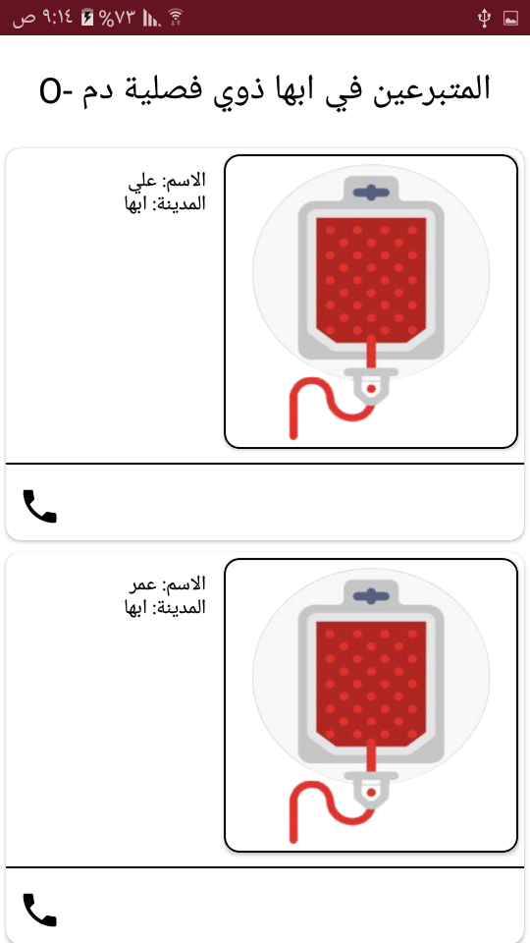
Bloodline: A System to Connect Blood Donors with Seekers
Results and discussion
The user can press on the search icon on the top left of the screen in figure 26 to access a form screen that requires two fields to fill city and blood group in figure 22 to search for blood donors in the chosen city as in figure 28.
Overview:
Tools and languages
Mapping design to implementation
Main codes
Testing
Results and discussion
Conclusion

Slide 21
Bloodline: A System to Connect Blood Donors with Seekers
Conclusion
 | BloodLine System
1 | Good documentation of the system following the agile approach guidelines. | Done
2 | Drawing diagrams to represent the structure, interaction, and data of the system. | Done
3 | A deep study of the previous systems. | Done
4 | Gathering the proposed system requirements. | Done
5 | Studying the obstacles that lie between patients reaching for donors. | Done
6 | Proposing a system that removes these obstacles and makes donors in reach. | Done
7 | Encouraging individuals to enter the donors’ community by providing a usable and reliable system for registration. | Done
8 | Building a database of donors that multiple users can reach for when there is a blood demand. | Done
9 | Implementing the proposed system | Done
10 | Testing the implemented system | Done
Overview:
Tools and languages
Mapping design to implementation
Main codes
Testing
Results and discussion
Conclusion

Slide 22
Bloodline: A System to Connect Blood Donors with Seekers
Limitation
Overview:
Tools and languages
Mapping design to implementation
Main codes
Testing
Results and discussion
Conclusion
The proposed system does not provide a service that checks the eligibility of the donors.
Leaving this task to be achieved by the authorized parties.

Slide 23
Bloodline: A System to Connect Blood Donors with Seekers
Overview:
Tools and languages
Mapping design to implementation
Main codes
Testing
Results and discussion
Conclusion
Future Work
a reliable authority collaborates in our system checking the eligibility of donors in a much reliable method.
it is planned to make the application support languages other than the Arabic language the application will support web and IOS devices.
part of the plan is to make the services of our application available for foreigners during hajj and umrah by connecting our application with applications provided by the government to these targeted users.

Slide 24
Thank you for listening
Bloodline: A System to Connect Blood Donors with Seekers

